Slide 1

Import Data Storage Domain
Maor Lipchuk
March 2015
Senior Software Engineer @ RHEV
Red Hat
mlipchuk@redhat.com
Irc.oftc.net server on #ovirt channel
Notes:
Good afternoon, welcome to the oVirt session on Disaster Recovery
my name is Maor Lipchuk, I work as a senior software engineer in RedHat, and I currently work on the oVirt project.
I want to talk to you about disaster recovery and the new feature introduced in oVirt 3.5 called “Import Storage domain”.
I will first say a few words about oVirt, how Disaster Recovery was used before version 3.5 and how it is used today in oVirt 3.5

Slide 2
oVirt in a Nutshell
Open Source project started by Red Hat
Virtualization management platform
Built on linux's virtualization you already know:
  kvm, qemu, libvirt
Manages:
Virtual Machines
Storage Domains
Virtualized networks
Notes:
ok, How many of you went to the oVirt virtualization lecture
oVirt is an open source virtualization managemennt platform,
it means it allows the administrator to do anything that is related to virtualization management and manage his virtual environment.
It is based on a leading technology like qemu to provide a fullstack for virtualization management.
and intends to be an open source alternative to manage virtualization.

Slide 3
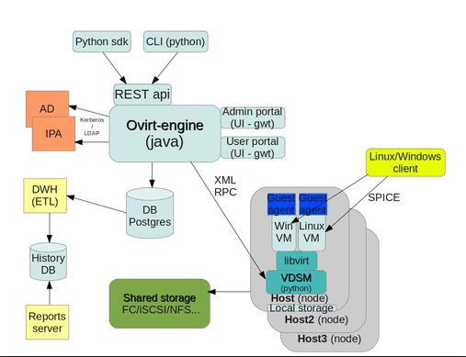
oVirt in a Nutshell
Notes:
I won't go into specific detail on every element in the architecture which presented here.
But in general oVirt consists of a centralized management engine which provides a graphical interface where an administrator can view, provision and manage one resources
Hosts which are using the Kernel-based Virtual Machine (KVM).
Agents and tools running on hosts including VDSM, QEMU, and libvirt.
These tools provide local management for virtual machines, networks and storage.
Storage domains to hold virtual resources like virtual machines, templates, ISOs.
A database to track the state of and changes to the environment.

Slide 4
oVirt in a Nutshell
File Storage Domains
  NFS
  Gluster
  POSIX-Compliant FS
  Local
Block Storage Domains
  Fibre Channel
  iSCSI
Notes:
So, today oVirt supports different types of Storage Domains.
I would like to go through them very quickly just to give a glance of what oVirt supports today...
So, first there is the Network File System which is the NFS
There is also the local Storage Domain.
Ovirt also supports both block Storage domains, which are the iSCSI Storage domain and the Fibre Channel Storage Domain.
Ovirt also supports the Gluster Storage Domain and also any other posix Compliant File System
Those are all the Data Storage Domains supported today by oVirt and can be used for adding disks, move disks to and from them, help with the VM hibernate process, and many other scenrios.

Slide 5
Disaster Recovery - Murphy's Laws
If there is a possibility of several things going wrong,
the one that will cause the most damage will be the one to go wrong
Smile... tomorrow will be worse.
You never run out of things that can go wrong.
If your advance is going well, you are walking into an ambush.
Nature always sides with the hidden flaw
If there is a worse time for something to go wrong,
it will happen then.

Slide 6
Disaster Recovery
Why do we need Disaster Recovery?
Machines and hardware fail
Humans make mistakes
Nature is unpredictable
Customers want access 24/7/365
Notes:
4 reasons why do we need Disaster Recovery
Machines & Hardware Fail - while it can be expensive for your company to eliminate any single point of failure in your IT infrastructure, it is really the only way you can be sure that a hardware failure will not interrupt your service and cause the minimal way of data loss
Humans Make mistakes - let’s admit it, we are not perfect
Customers want access 24/7/365
Nature is unpredictable

Slide 7
Disaster Recovery in oVirt

Slide 8
Disaster Recovery in oVirt
Export Storage Domain
File Storage Domain
Based on OVF
Can be used to migrate entities between different setups or Data Centers
Can be moved between setups
Can be used to backup entities
Notes:
Ok, so as we discussed in one of the previous slides, one of the Storage Domain which oVirt supports is the Export Storage Domain.
That type of Storage Domain was used commonly for this specific scenarios that involved migration of Vms and Templats from One Data Center to another.
Just a reminder, from the past slide, The export Storage domain acts as a container for Vms and Templates... it can be used for backup purposes, migration between different Data Centers or migrating between different Setups.
What are the problems?

Slide 9

Disaster Recovery in oVirt
Problem #1 : Scalability
Maintain a large amount of storage
Notes:
Scalability – peta byte, support a whole Data Center

Slide 10






Disaster Recovery in oVirt
Problem #2: Copying data takes too long
Notes:
Every I\O operation is very expensive

Slide 11

Disaster Recovery in oVirt
Problem #3: Single point of failure

Slide 12
Introduced in oVirt 3.5

Slide 13
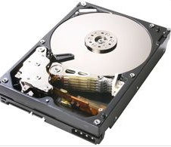
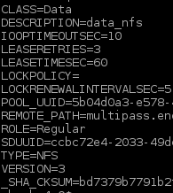
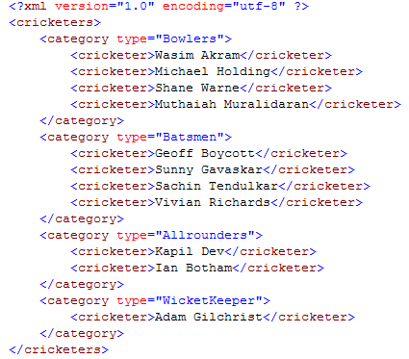
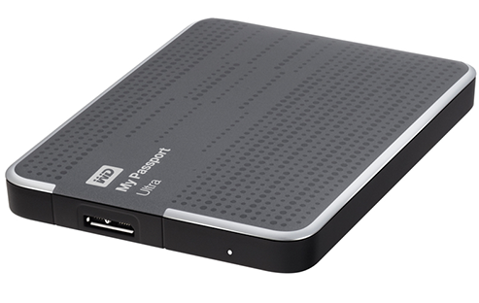
New capabilities in oVirt 3.5
Metadata
OVF_STORE disk
Disks
Notes:
What was introduced in oVirt 3.5
After going through the different types of Storage Domains,
I would like to get a bit “under the hood” of a Storage domain, and describe what does it contains under it...
For each Data Storage Domain we have the Meta Data... the meta data is a file, containing all of the meta data relates to the Storage domain, such as name, type., description and so on....
Other trivial contents contained in the Storage Domain are, of course, the disks...
The disks are hosted in the Storage Domain, containing also, a meta data, additionally to the data it self which might also contain snapshots, if they got any.
One of those disks, is the OVF_STORE disk.
The OVF_STORE disk is a special disk introduced lately in oVirt 3.5, this disk is created automatically by the engine, and its main purpose is to
contain all of the Vms and the Templates configurations, which have disks on the Storage Domain, in this disk.
All of this configuration data, preserved in a XML standard called Open Virtualization Format, or simply OVF.
The OVF is a xml representation of the VM or the Template configuration, it is mainly describes all the VM data, such as name, description, number of disks, snapshots and more.
Before oVirt 3.5 all of the VM and template OVF files were preserved directly in the Storage Domain at a special path.
Now, with this disk introduced in oVirt 3.5 we are able to support Disaster Recovery scenarios and with them the Import Storage Domains feature

Slide 14
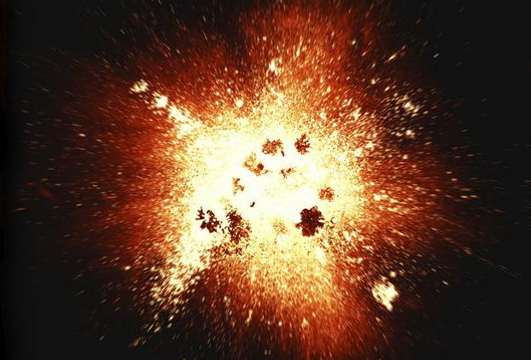
Disaster Recovery Today
yet another beautiful disaster...

Slide 15
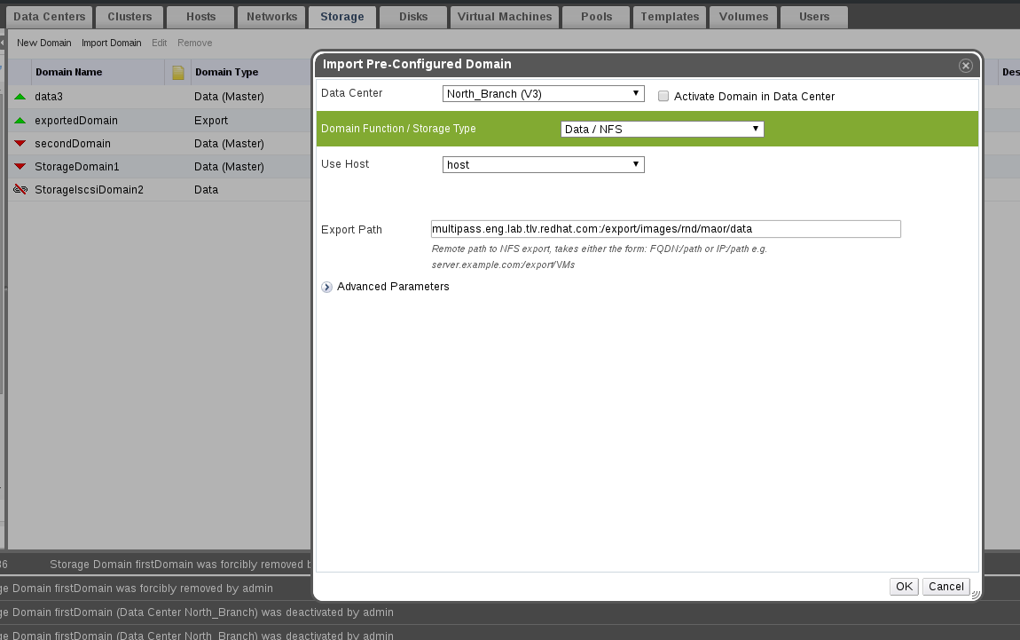
Disaster Recovery Today
Import a Storage Domain after a disaster

Slide 16
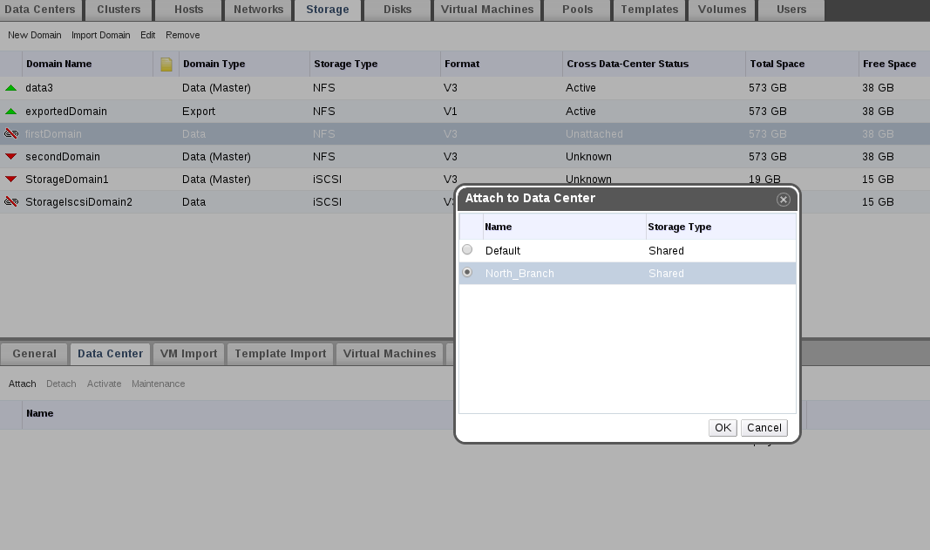
Disaster Recovery Today
Attach and activate the Storage Domain on the target Data Center

Slide 17
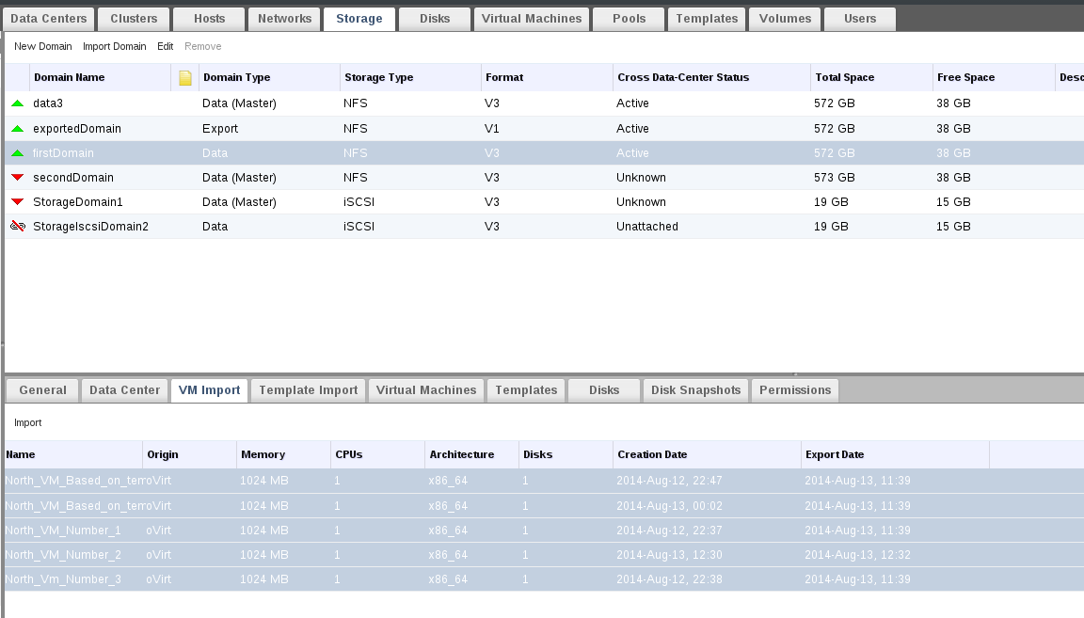
Disaster Recovery Today
Pick the entities you want to register from the newly attached Storage Domain

Slide 18
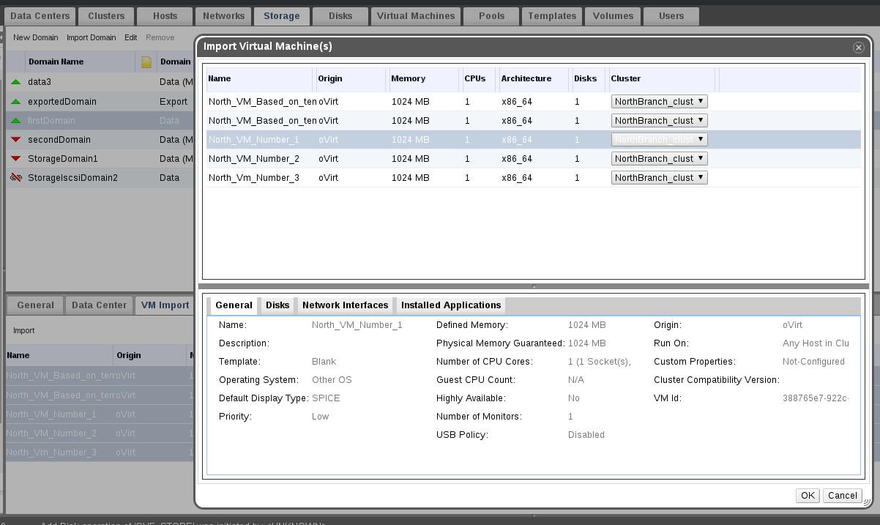
Disaster Recovery Today
Choose a Cluster and Quota for each entity

Slide 19
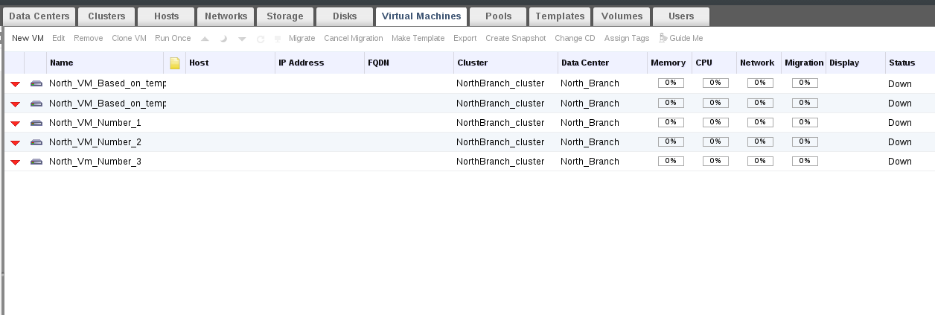
Disaster Recovery Today
Done!

Slide 20
Then VS Now

Slide 21
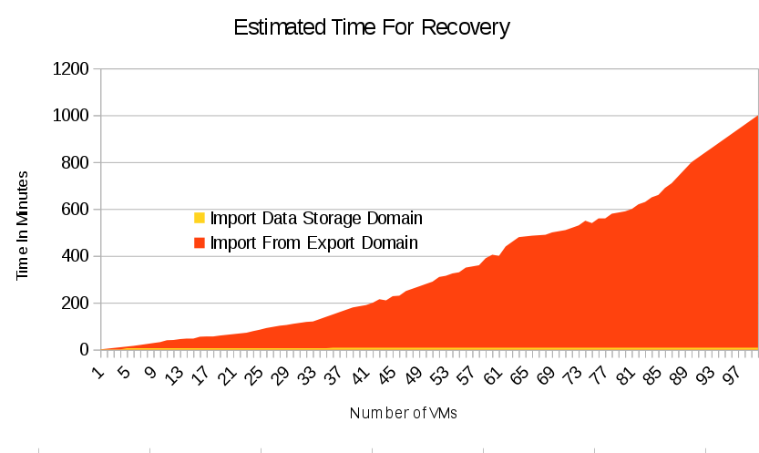
Comparison of DR Solutions

Slide 22
Now VS The Future

Slide 23
Future Plans
Clone VMs and Templates from a Storage Domain
Convert an Export Domain to a Data Domain
Your contributions are welcome: http://www.ovirt.org/Community

Slide 24
Wiki links
www.ovirt.org/Features/ImportStorageDomain
www.ovirt.org/Features/ImportUnregisteredEntities
YouTube videos
https://www.youtube.com/watch?v=DLcxDB0MY38 - Detach and attach Storage Domain with entities
https://www.youtube.com/watch?v=YbU-DIwN-Wc - Import file Storage Domain
https://www.youtube.com/watch?v=T03ai6FrMI4 - Recovery of local Data Center

Slide 25
Questions?

Slide 26
THANK YOU !
http://www.ovirt.org
http://lists.ovirt.org/mailman/listinfo
#ovirt irc.oftc.net
mlipchuk@redhat.com

